Slide 1

Electricity Forecast Austria
By Jonas Welt, Karim Ortner & Lorenz Johannes Schlosser

Slide 2
Contributions & GitHub
Jonas – Preprocessing, Code architecture, Refactoring
Karim – dataset aquisition, documentation, presentation, visualization (EDA)
Lorenz - dataset aquisition, project structure, model selection, visualization
Github: https://github.com/LSchlosser/TIS3_CapstoneProject/tree/main/data

Slide 3
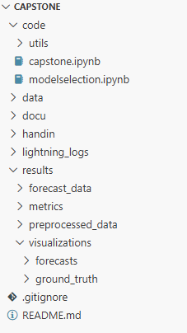
GitHub – Folder Structure

Slide 4

Business Problem
Problem
Austrian electricity prices fluctuate daily due to supply-demand, renewable generation, and market dynamics.
This makes forward cost planning and procurement timing challenging.
Forecasting helps:
Utilities: improve procurement planning and budget accuracy
Businesses: anticipate seasonal energy cost changes and plan operations accordingly
Policymakers: gain forward-looking price signals to support cost monitoring and planning
Value
Monthly price forecasts provide directional price visibility, enabling more proactive decision-making and reducing reliance on reactive responses to price volatility

Slide 5
Solution
Steps Taken:
Data Engineering
Exploratory Data Analysis
Feature Engineering
Modeling
Evaluation
Forecast

Slide 6

Data source & description
Source: European wholesale electricity price data (daily)
Link: https://ember-energy.org/data/european-wholesale-electricity-price-data/
Scope: Austria
Variables: Date, Price (EUR/MWh)
Processing: Aggregate daily → monthly averages, add lagged/additional features

Slide 7
Data Engineering
Filter data for AUT
Standardize schema to “unique_id”, “ds” & “y”
Two frequencies prepared:
Daily : original daily prices used to train daily forecasting models
Monthly : daily prices aggregated to monthly averages and used to train monthly forecasting models
Chronological split to prevent data leakage:
Training: data before January 2025
Validation: January–December 2025
Test: reserved for future evaluation (2026 onward)
Same split strategy applied to both daily and monthly datasets

Slide 8
Data Engineering
For Evaluation:
Daily forecasts aggregated to monthly averages for evaluation
Monthly models evaluated directly
Enables fair comparison of forecasting approaches
For Reproducibility:
Preprocessed data stored as CSV files
Cached loading for consistent results

Slide 9
Insights
Historical trends & seasonality (higher prices in winter, lower in summer)
Spikes are short-lived → market shock events
Clear year-over-year upward trend, especially after 2021 (energy crisis)
Holiday periods can distort demand (e.g., Christmas, New Year)

Slide 10
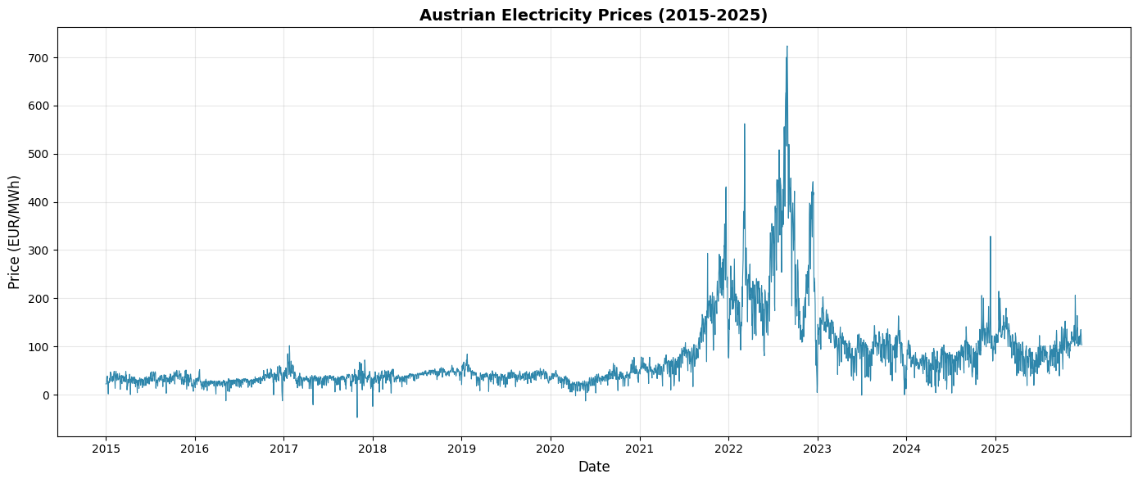
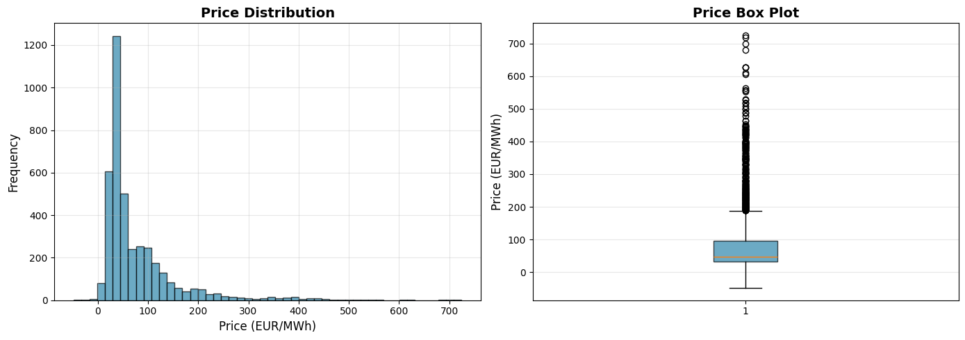
Insights

Slide 11
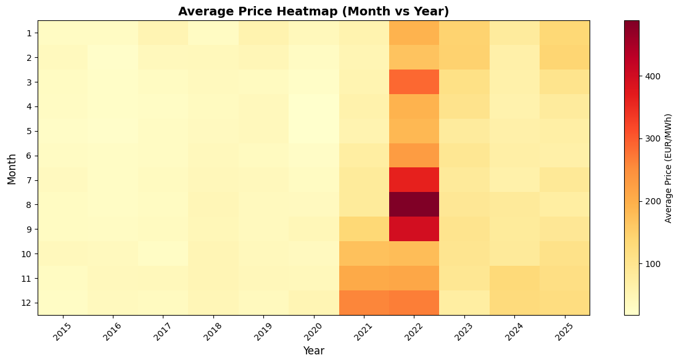
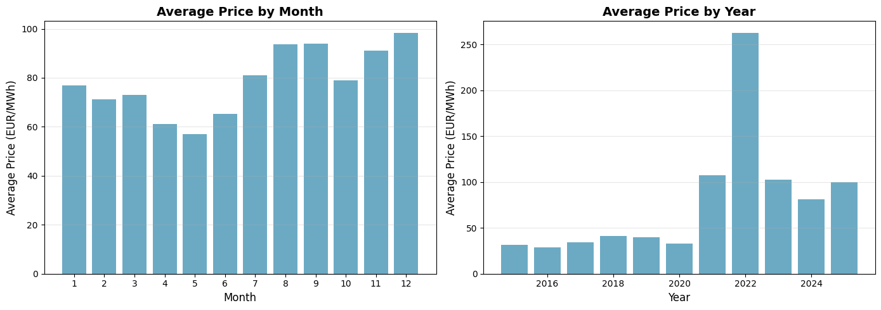
Insights

Slide 12
Feature Engineering
Capture temporal dependencies and seasonal effects
Different features for daily and monthly models
Enables models to learn short-term dynamics and long-term trends

Slide 13
Feature Engineering
Feature Type | Daily Features | Monthly Features
Lags | 1 day, 1 week, 4 weeks, 1 year | Last month, last quarter, half-year, last year
Rolling stats | 7-day mean, 30-day mean | 3-month mean, 12-month mean
Holiday | Binary indicator for public holidays | Monthly aggregated holiday counts
Date features | Day of week, month, quarter | Month, quarter
Lag-based rolling stats | Short-term volatility, weekly/monthly smoothing | Same transformations at monthly scale

Slide 14
Modeling
Model Type | Examples | Purpose / Notes
Baseline | Seasonal Naive, Random Walk w/ Drift, Historic Average, Structural | Simple, interpretable, computationally cheap; sets performance floor
Statistical | SES, Holt, Holt-Winters, AutoETS | Capture trend and seasonality efficiently; balance simplicity and sophistication
Machine Learning | Linear Regression, Huber Regressor, Random Forest, LGBM | Learn non-linear patterns and feature interactions; lag-enhanced version includes lags, rolling stats, holidays
Deep Learning | NHITS, KAN, RNN, LSTM | Capture complex, hierarchical, and long-term temporal patterns; daily vs monthly input sizes and horizons adapted
Four paradigms: Baseline, Statistical, Machine Learning, Deep Learning
Separate training for daily and monthly frequencies
Chronological training preserves temporal structure

Slide 15
Evaluation
Forecasts compared to actuals on validation split
Daily forecasts aggregated to month for alignment with monthly metrics
Metric | Purpose
MAE | Average absolute deviation (EUR/MWh), robust to spikes
RMSE | Penalizes large errors, highlights models avoiding big misses
MAPE | Scale-free %, facilitates comparison across periods; careful with low values

Slide 16
Evaluation
Only forecast columns used for scoring; identifier/date columns excluded
Missing values dropped before scoring
Results sorted by MAPE and saved as CSVs for reproducibility
Model selection through MAPE
Visual diagnostics: predicted vs actual, residuals, prediction intervals

Slide 17
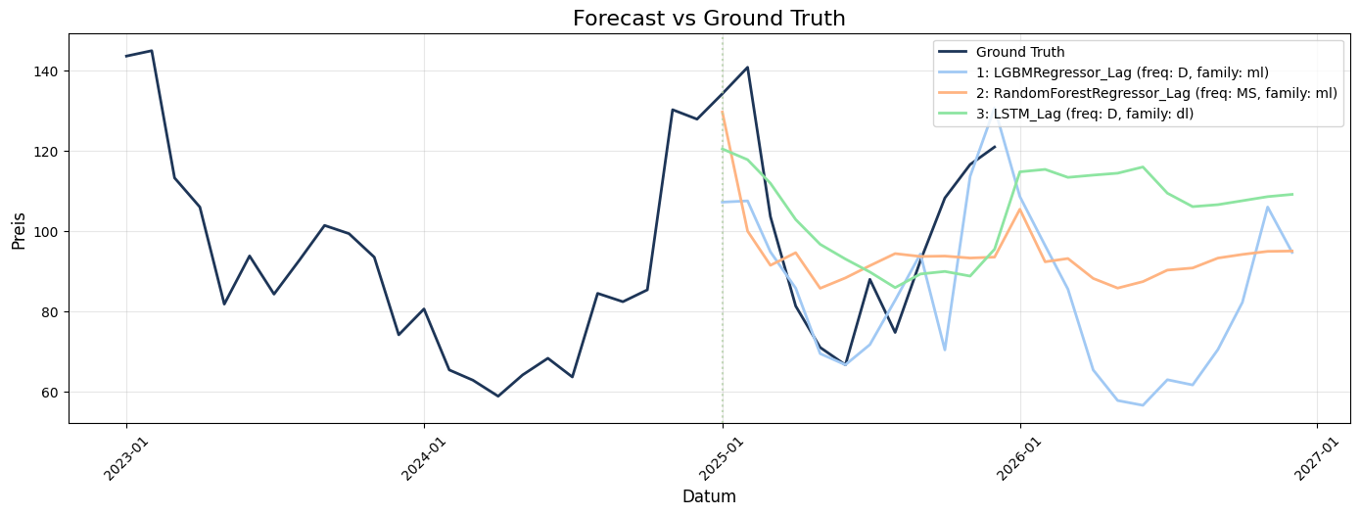
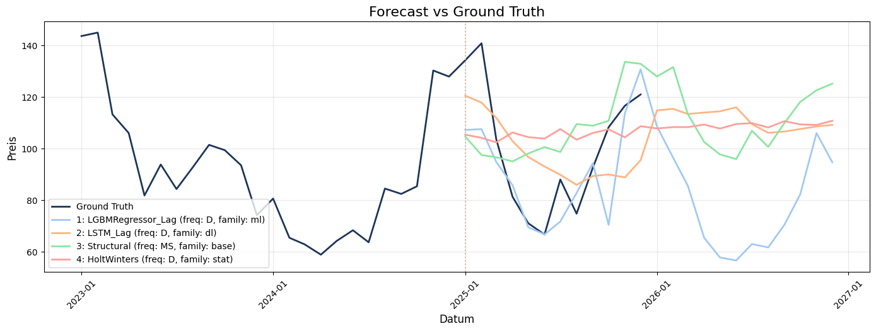
Forecast

Slide 18
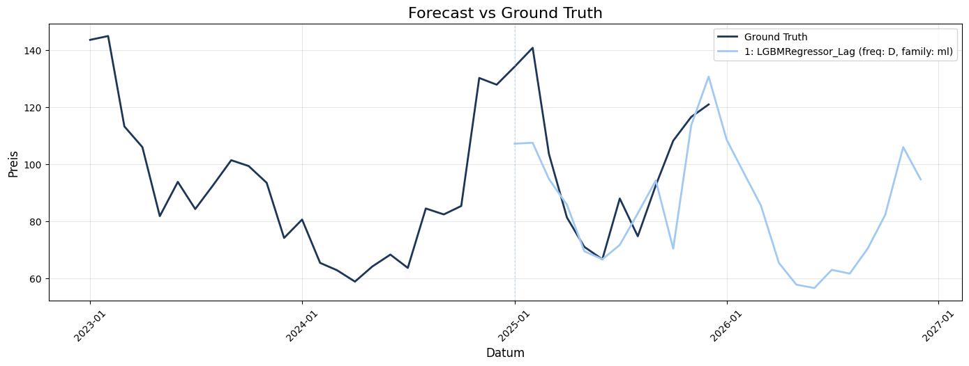
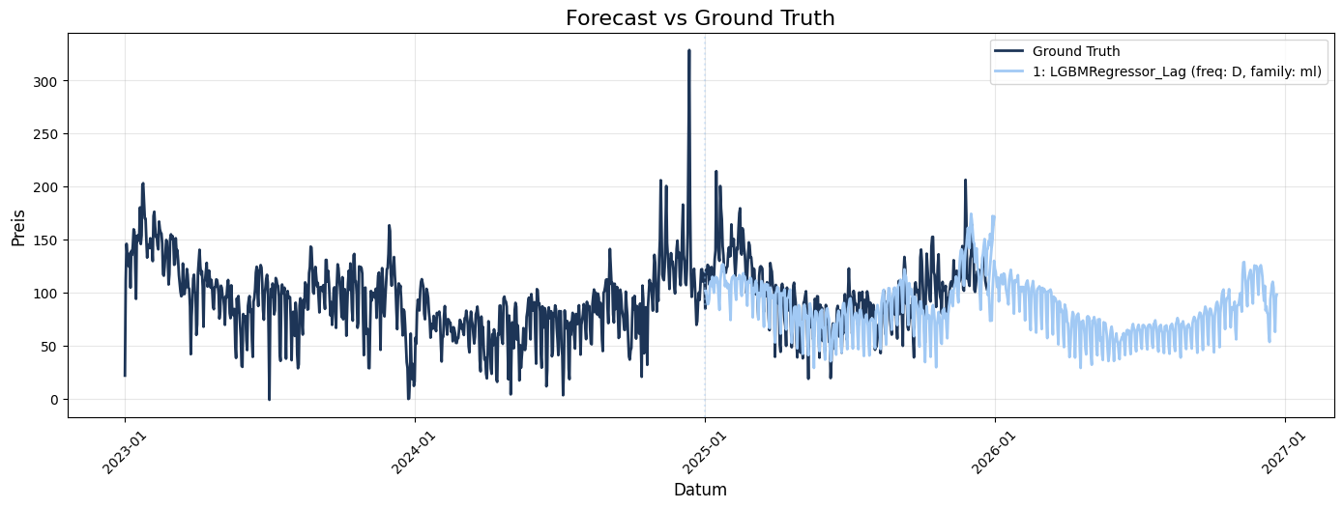
Forecast

Slide 19
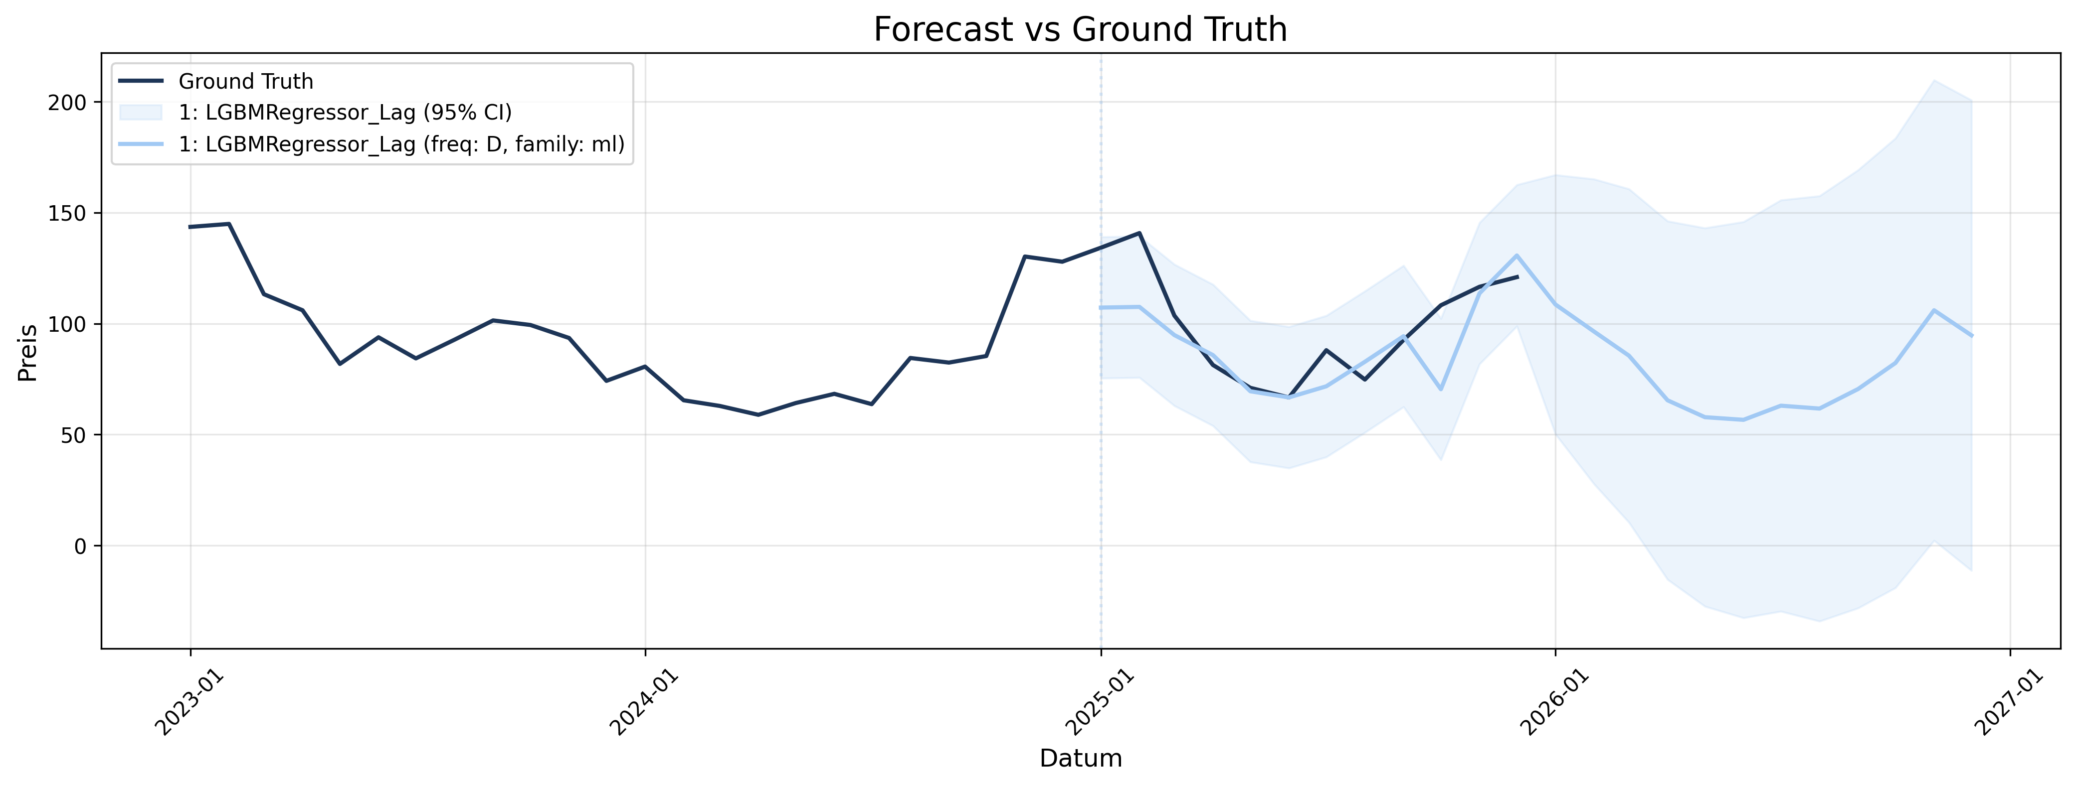
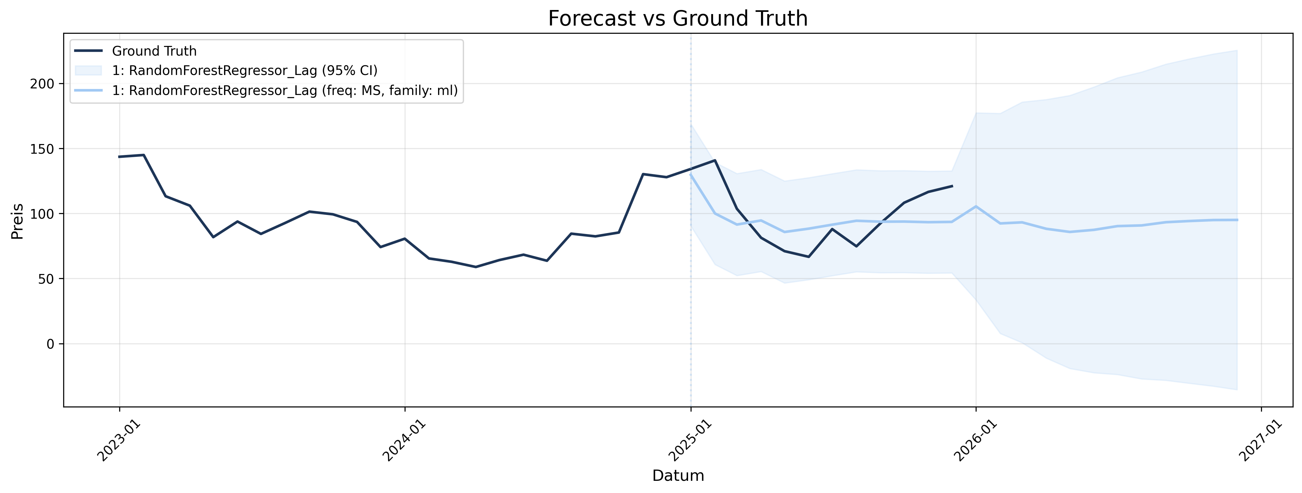
Forecast

Slide 20
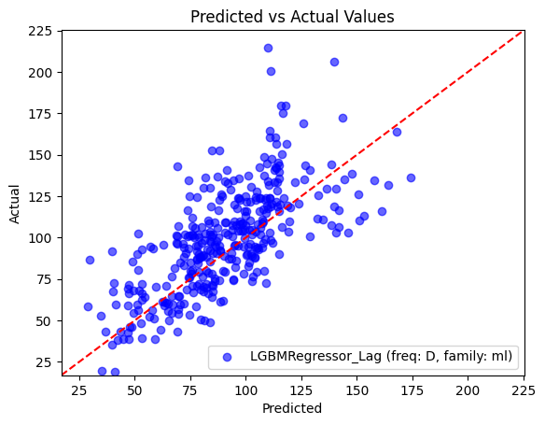
Forecast

Slide 21
Value/ Decision-Making
Actions enabled:
Schedule energy procurement in advance
Adjust trading strategies
Optimize energy-intensive production
Impact:
Reduced costs due to better planning
Mitigate risks from price spikes
Without forecasts → reactive decisions, higher costs

